Slide 1
DATA ANALYSIS: TECHNICS AND TOOL PROJECT
Bank Marketing Campaign
Mattia Moretti, Edoardo Santucci

Slide 2
Introduction
The dataset used for this project comes from a bank which offers its clients a subscription to a term deposit by calling them. We want to study the best way to call clients to have an higher probability of subscription to the term deposit.
The dataset contains 11162 observations and 17 attributes which are described in the next slide.

Slide 3
Age | Costumer age; numeric variable: ranges from 18 to 95
Job | Job of costumers; nominal variable;
Marital | Costumers’ marital condition; nominal variable;
Education | Costumers’ education; nominal variable;
Default | Client has credit in default; binary variable;
Balance | Average yearly balance in euro; numeric variable;
Housing | Clients have housing loan; nominal variable;
Loan | Clients have personal loan; nominal variable;
Attributes | Description
Contact | Contact communication type; nominal variable;
Day | Last contact day of the week; categorical variable;
Month | Last contact month of the year; nominal variable;
Duration | Last contact duration in second; numeric variable;
Campaign | Number of contacts performed during this campaign for this client; numeric variable;
Pdays | Number of days that passed by after the client was last contacted from a previous campaign ( -1 means not previously contacted); numeric variable;
Previous | Number of contacts performed before this campaign for this client; numeric variable;
Poutcome | Outcome of the previous marketing campaign; nominal variable;
Deposit | The client has subscribed a term deposit during the current campaign; binary variable

Slide 4
The aim of this analysis is to provide answers to the following questions:
How is the dataset structured? Are there any correlations between attributes?
Which attributes are more present between clients who subscribe the term deposit?
How can the subscription be predicted?

Slide 5
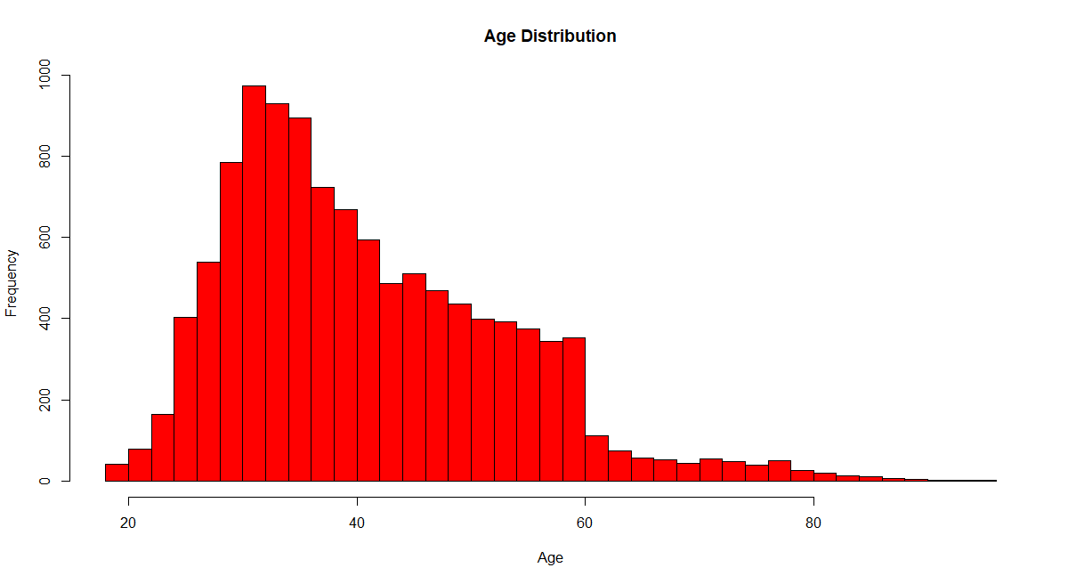
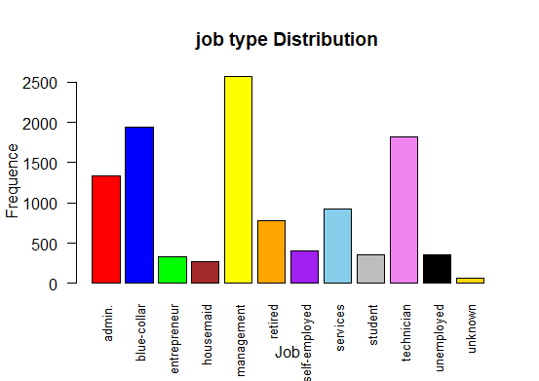
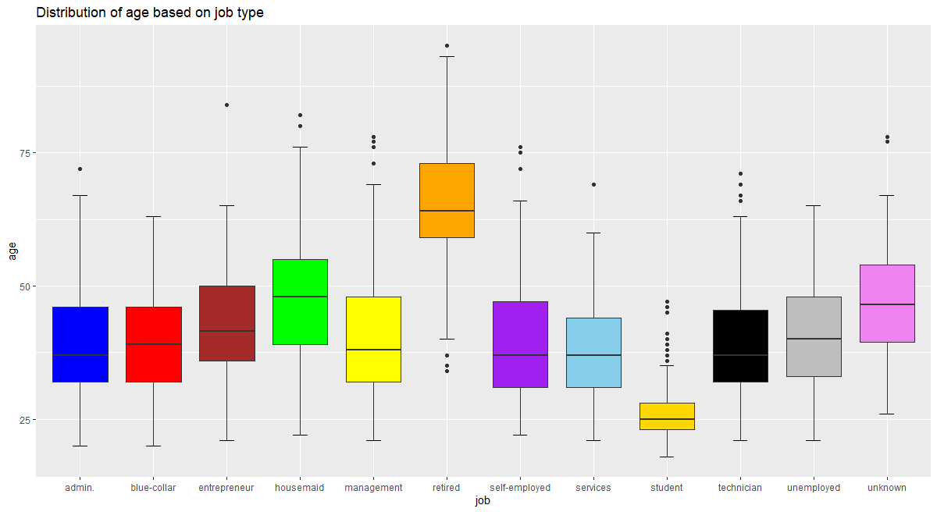
Exploratory data analysis
Figure 1: histogram for age
Figure 2: barplot for job
Figure 3: boxplot for age based on job type

Slide 6
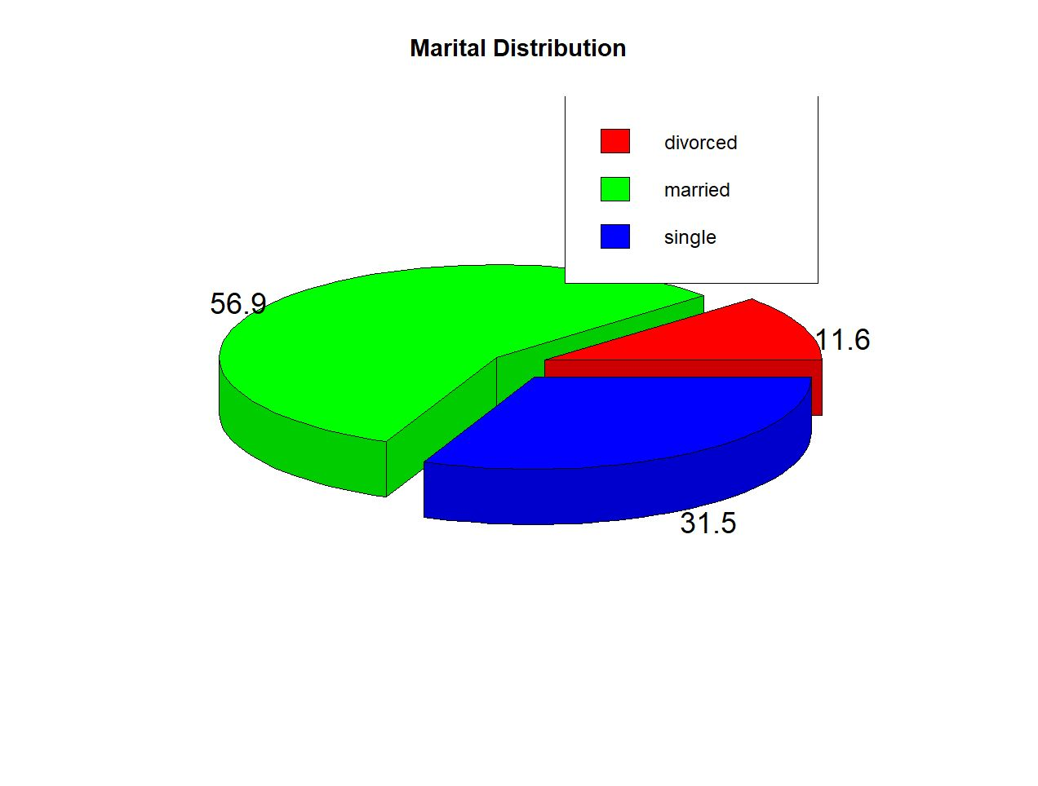

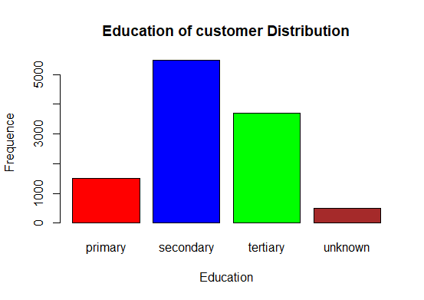

Figure 5: barplot for education
Figure 4: pie chart for marital distribution

Slide 7
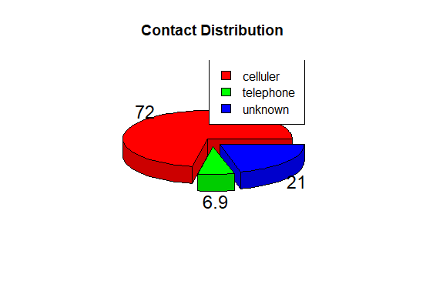

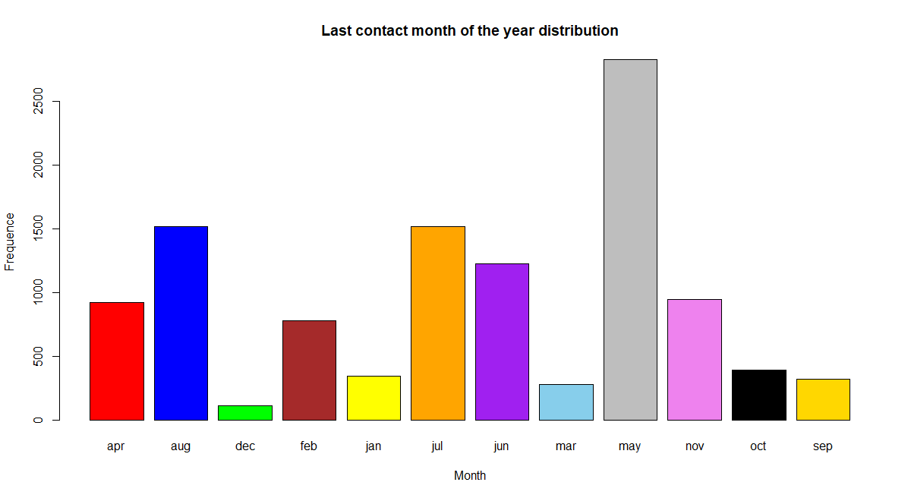
Figure 6: pie chart for contact distribution
Figure 7: bar plot for last contact month of the year

Slide 8
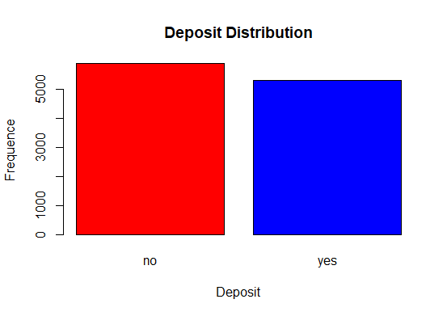
What is a term deposit?
A time deposit or term deposit is a deposit in a financial institution with a specific maturity date or a period to maturity, commonly referred to as its "term". Time deposits differ from at call deposits, such as savings or checking accounts, which can be withdrawn at any time, without any notice or penalty. Deposits that require notice of withdrawal to be given are effectively time deposits, though they do not have a fixed maturity date.
A term deposit is a fixed-term investment that includes the deposit of money into an account at a financial institution. Term deposit investments usually carry short-term maturities ranging from one month to a few years and will have varying levels of required minimum deposits.
The investor must understand when buying a term deposit that they can withdraw their funds only after the term ends. In some cases, the account holder may allow the investor early termination or withdrawal if they give several days notification. Also, there will be a penalty assessed for early termination.
Figure 8: bar plot for deposit distribution

Slide 9
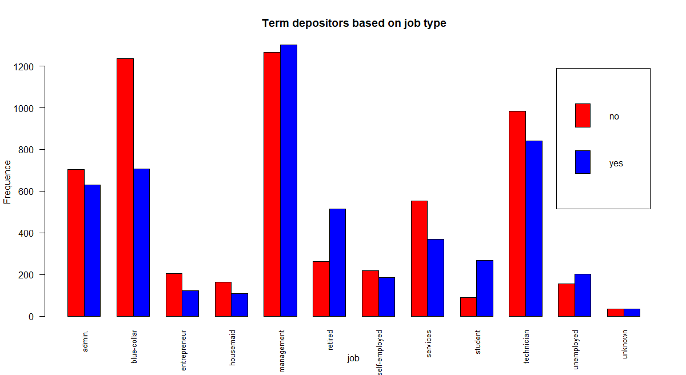
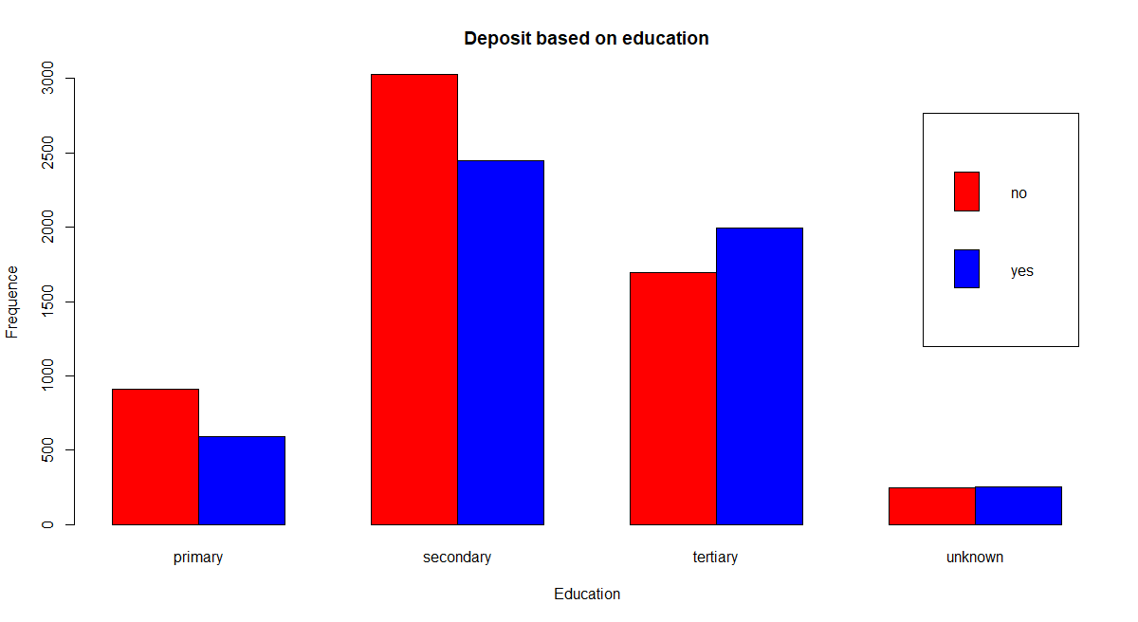
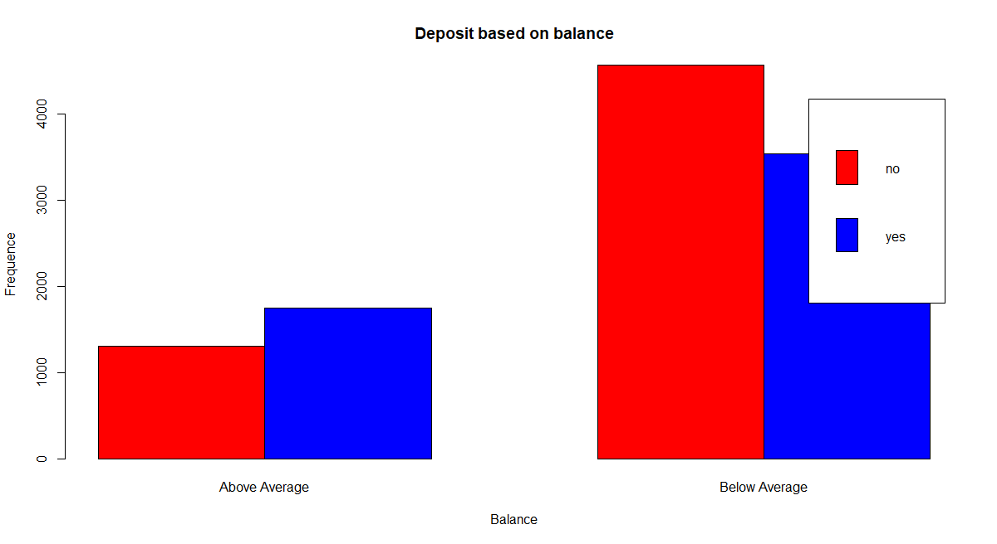
Figure 10: deposit based on education
Figure 9: bar plot for depositor based on job
We can see (fig. 9,10,11) that people more educated, with more money and higher job are more likely to subscribe the term deposit; this consideration makes us think that people who subscribe the term deposit are more financially educated than people who don’t subscribe the term deposit
Figure 11: deposit based on balance

Slide 10
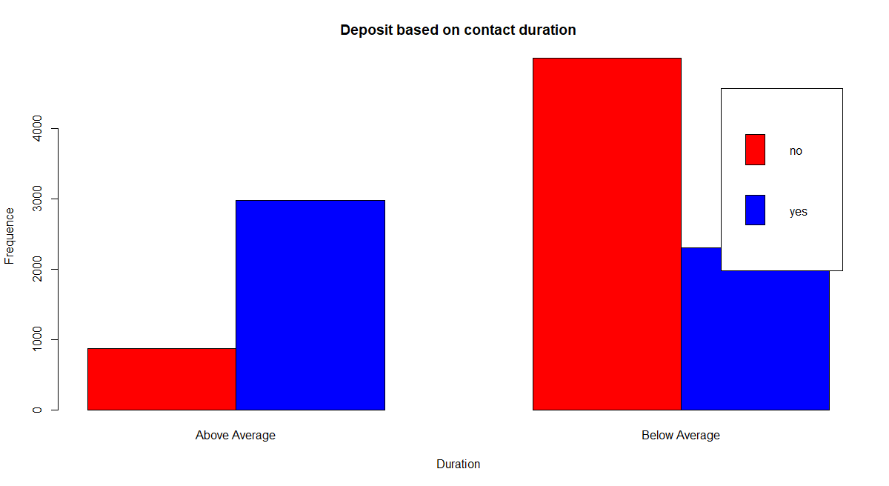
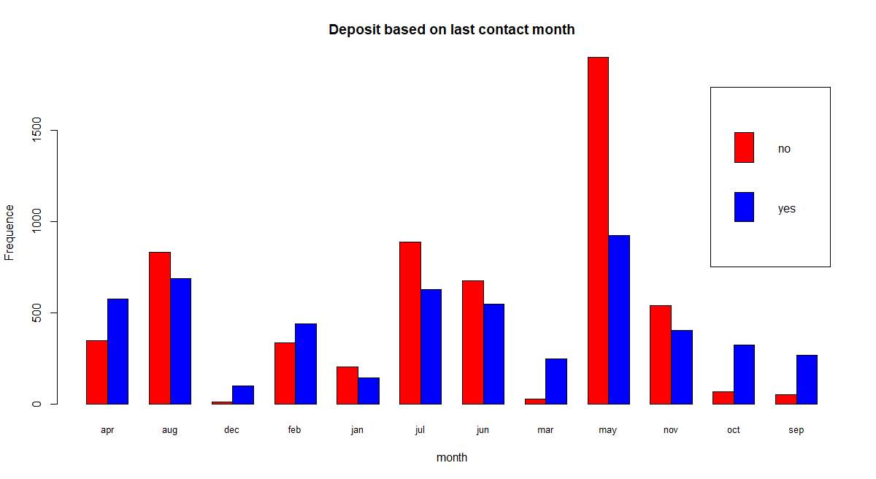
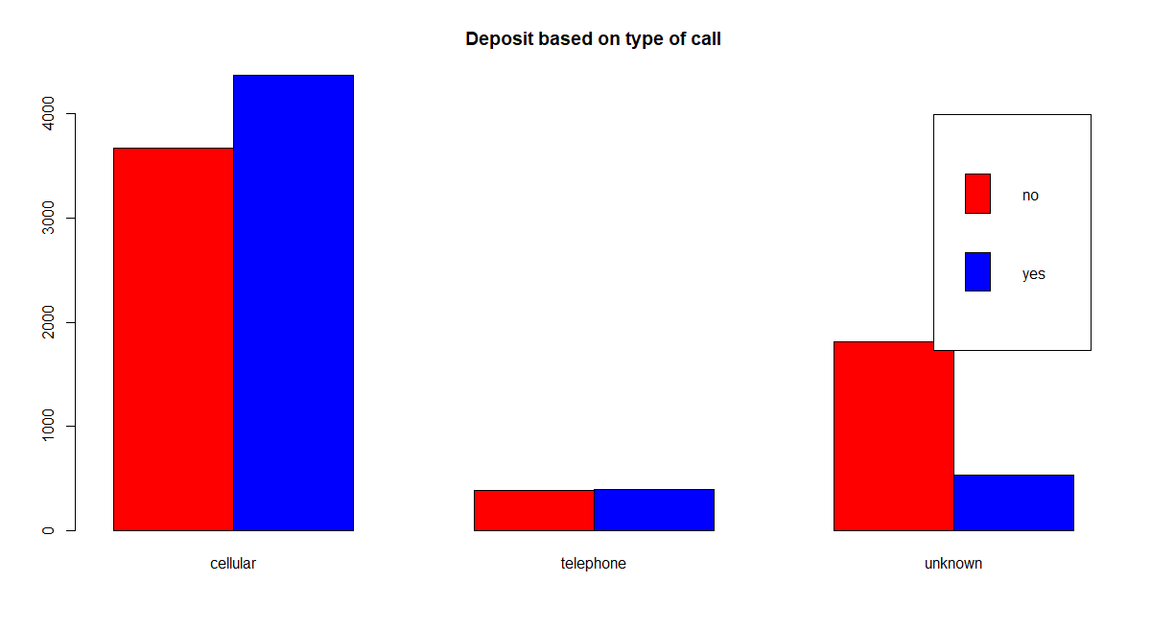
Figure 12: bar plot for deposit based on call duration
Looking at figures 12, 13 and 14 we can deduct that the type, the time and the duration of calls are quite important.
The most important aspect here is the duration of call, infact when the call last above the average duration there is an important higher probability that the client will subscribe the term deposit.
Figure 14: bar plot for deposit based on last contact month
Figure 13: bar plot for deposit based on type of call

Slide 11
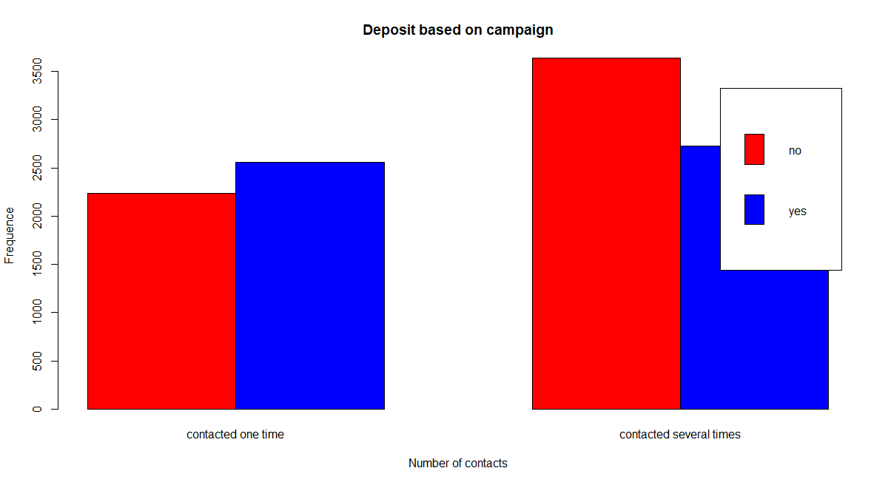

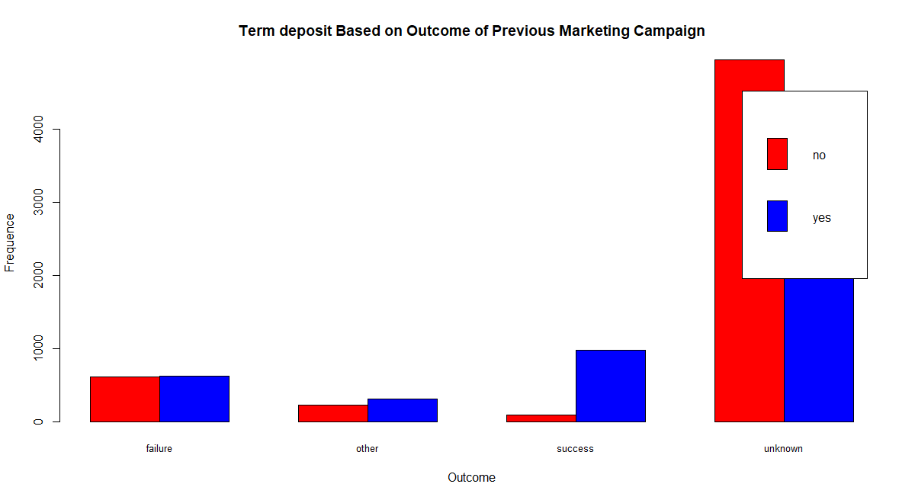

Figure 15: bar plot for deposit based on campaign
Figure 16: bar plot for deposit based on outcome of previous campaign

Slide 12
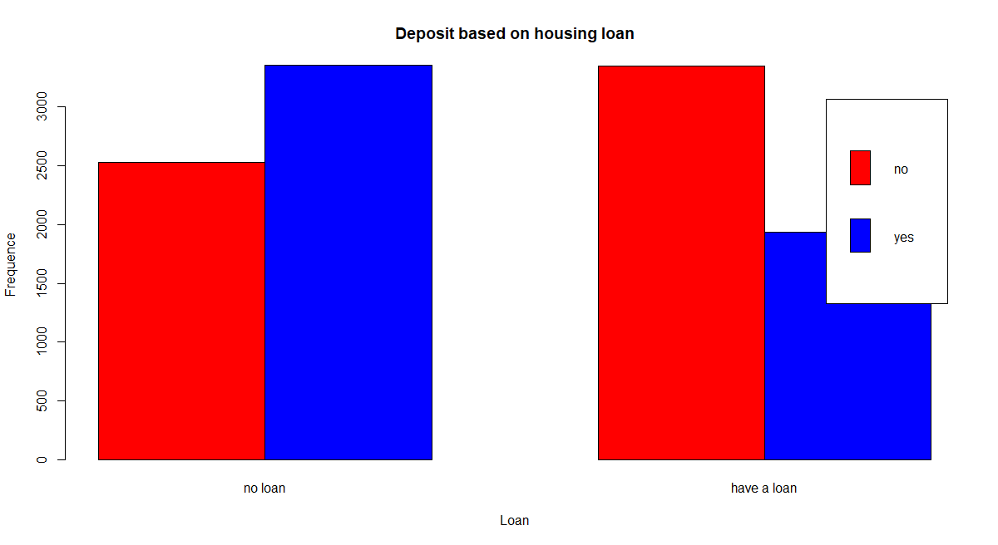

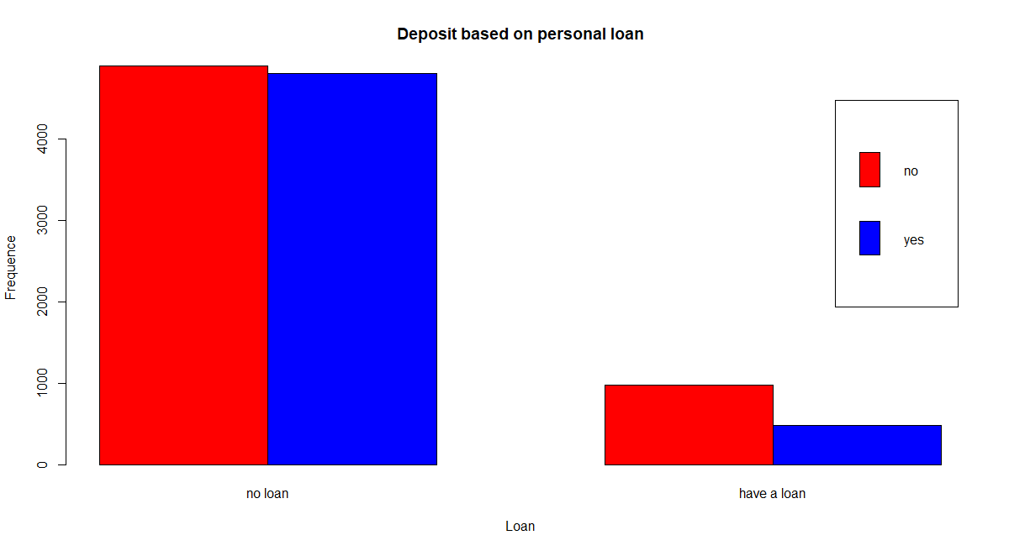

Figure 17: bar plot for deposit based on havin an housing loan
Figure 18: bar plot for deposit based on having a personal loan

Slide 13
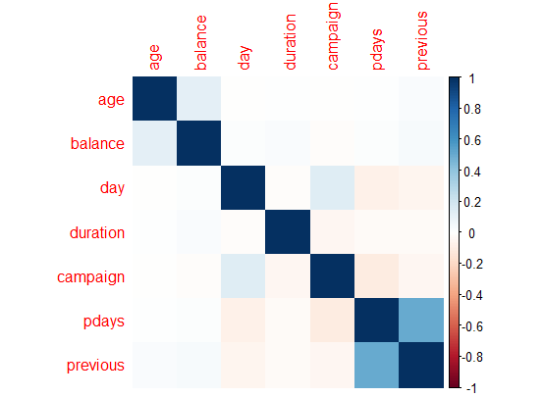
CORRELATION ANALYSIS
Figure 19: correlation analysis

Slide 14
WHAT CONCLUSIONS CAN WE DEDUCT FROM THE EDA?

Slide 15
BAYES CLASSIFIER
Naive Bayes classifiers perform very well in practice and are highly valued in domains in which large numbers of descriptive attributes have to be considered. This classifier works so well that it is generally used as a baseline for the other model, therefore, we decided to apply it first to our dataset.
 | YES | NO
YES | 936 | 218
NO | 283 | 795
table(Bank.test$deposit, Bank.pred)

Slide 16
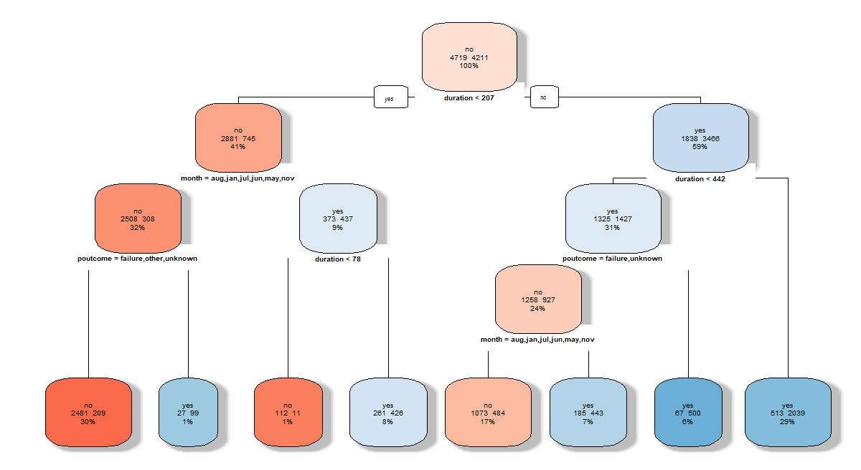
DECISION TREE
Figure 20: decision tree
 | YES | NO
YES | 921 | 233
NO | 191 | 887
table(Bank.test$deposit, Bank.predict)

Slide 17
RANDOM FOREST
Forests of trees have the advantage that they are more stable than classical decision trees and offer better performance.
 | YES | NO
YES | 947 | 207
NO | 212 | 866
table(Bank.test$deposit, Bank.rf_predict)

Slide 18
Thank you for your attention!

